Slide 1
TABLEAU
Assignment

Slide 2
Assignment:
1. Find the sales for every year.
2. Find year for highest sales and lowest sales respectively.
3. show the view in bar graph.
4. Add label to your view.
5. Find the category wise sales for every year.
6. Which category has highest sales in the year 2020 & 2021. 7. Based on the analysis of the year 2020 & 2021. give some suggestions to improve Sales in the year 2022.
8. Display subcategory and find some insights from the view about max and min sales under every category.
9. Change the color of your visual.
10. Check the Tooltip.
11. In your bar graph, present subcategory under each bar of category using color card

Slide 3
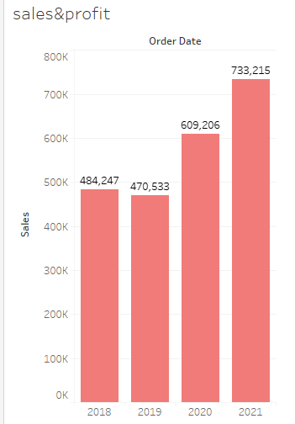
1)find the sales for every year?
2)highest sales in 2021
733,215
lowest sales in 2019
470,533
3)showing the Bar graph
4)Adding the label

Slide 4
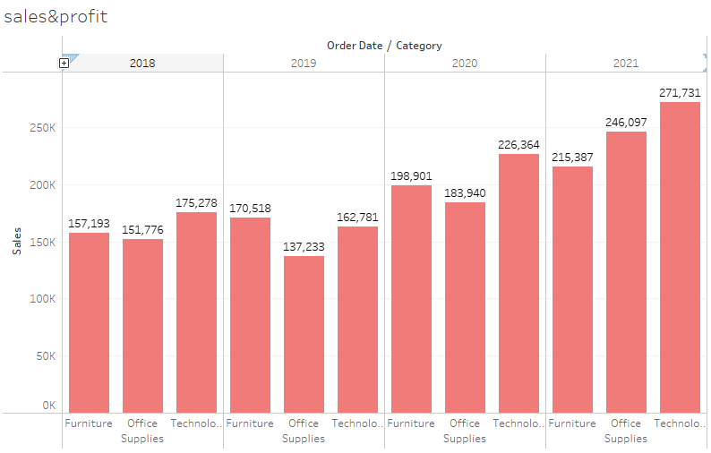
5)find the category wise sales for every year.
6)Technology is
Highest sales in
2020 and 2021

Slide 5
7) Based on the analysis of the year 2020 & 2021. give some suggestions to improve Sales in the year 2022.
Here can be increase the storage capacity some online and offline marketing might give boost the other categories apart from technology.

Slide 6
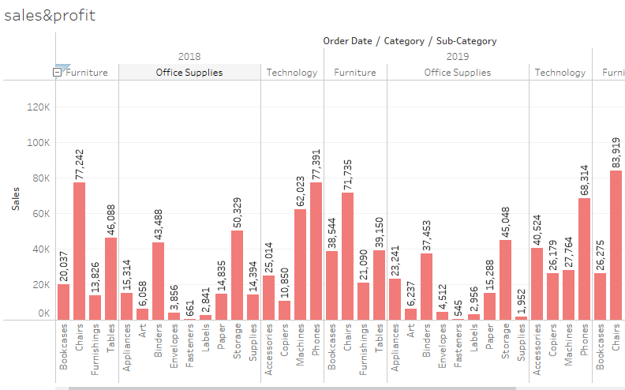
8)display subcategory and insights check the maxi and mini sales in every category.

Slide 7
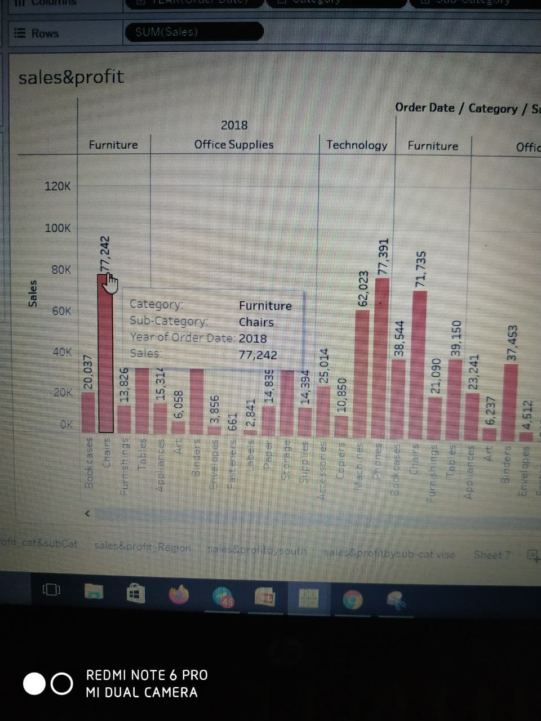
9) change the color of visual.
10)check the tooltip

Slide 8
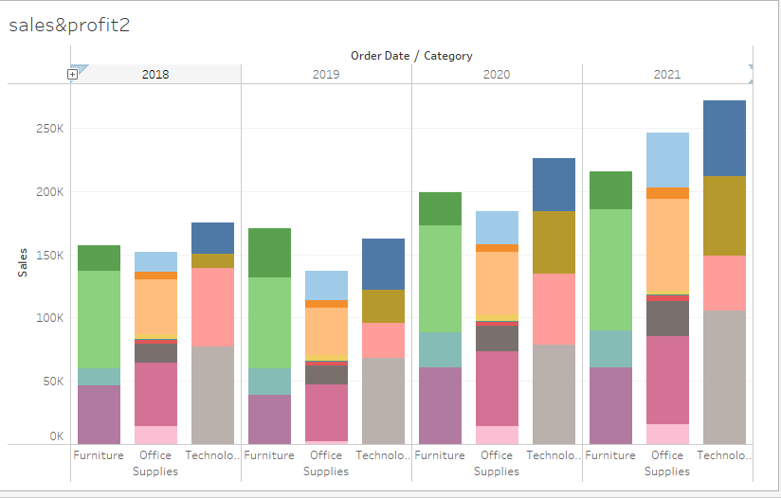
11) In your bar graph, present subcategory under each bar of category using color card.

